Slide 1
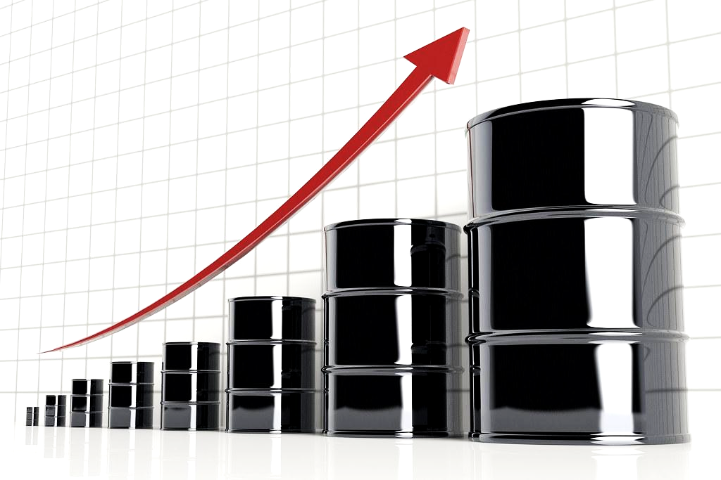
Economic variables on Crude Oil prices in the US and Canada
Presenters:
Anjila Ghimire, Jun Jiang and Jasleen Kaur

Slide 2
INTRODUCTION
OBJECTIVES
RESEARCH QUESTIONS
CONCLUSIONS
01
02
03
04

Slide 3

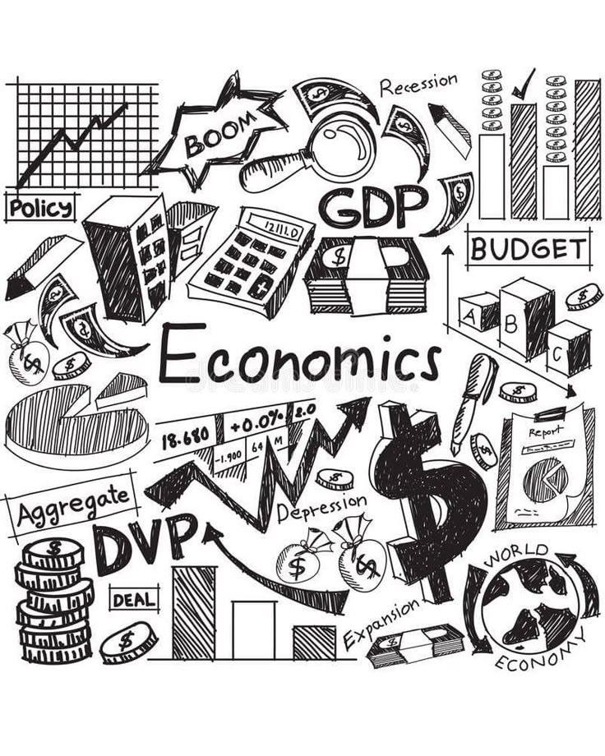


Introduction
Our project aims to explore the intricate relationship between crude oil prices and economic variables such as supply and demand dynamics, inflation, interest rates, exchange rates, and economic growth. We will examine historical trends, analyze key economic indicators, and assess how global events—such as recessions, trade policies, and technological advancements—affect crude oil markets.

Slide 4
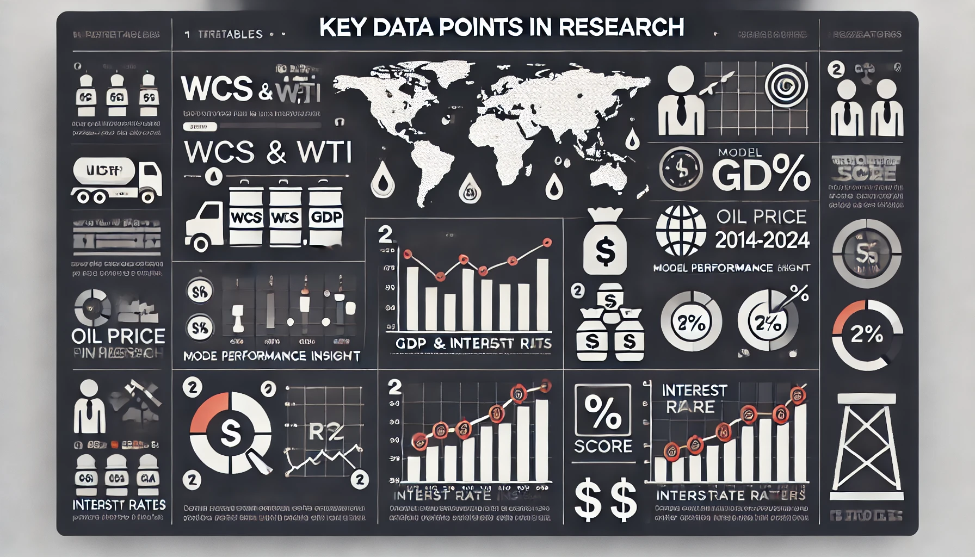
PORTFOLIO
Project #4
#

Slide 5
Objectives
Our research project included five key data points:
Variables: WCS(Canada), WTI(USA), GDP, Interest Rates, and a Geopolitical Indicator.
GDP and Interest Rates: We incorporated GDP and interest rates from both Canada and the USA, along with crude oil prices, covering the period from 2014 to 2024.
Geopolitical Indicator: We used global crude oil data after observing a poor R² score when relying solely on Canada and USA GDP and interest rates as independent variables

Slide 6
Research Questions:
1
WCS and WTI vs GDP
2
WCS and WTI vs Interest & Inflation
3
WCS and WTI vs Geopolitical Risk

Slide 7
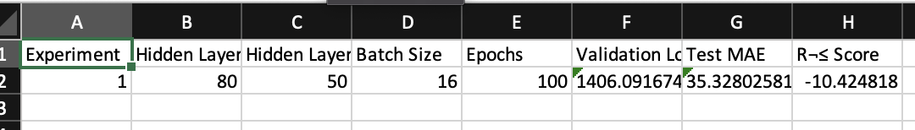
WCS vs GDP
Methodology: Developed a predictive model using machine learning techniques, including Neural Networks and XGBoost, within Spark.
Key Findings:
GDP growth has a moderate correlation with WCS price changes.
Economic downturns lead to greater volatility in WCS prices.
The strength of the GDP-WCS relationship varies across countries.
Interpretation:
GDP alone does not fully explain WCS price fluctuations, resulting in a poor R² score.
Additional macroeconomic factors should be incorporated to improve model accuracy.
.
.
Notes:
Model Results:
Initial Neural Network Model: Poor R² Score (-10.42).
Optimization Strategies:
Incorporate inflation rates, trade policies, and market demand data to improve accuracy.
Explore time-series modeling techniques and extend the data timeframe for better predictions

Slide 8
WTI vs GDP
Objective: To analyze how GDP influences WTI price percentage changes.
Key Findings:
GDP Growth has a moderate correlation with WTI price changes.
Economic downturns lead to greater volatility in WTI prices.
Some countries exhibit stronger GDP-WTI relationships than others.
Interpretation:
GDP alone does not fully explain WTI price fluctuations, contributing to the poor R² score.
Additional macroeconomic factors should be included to improve predictive accuracy.
Notes:
Enhancing Model Accuracy:
Incorporate inflation rates, trade policies, and market demand for a more comprehensive model.
Use time-series forecasting techniques and expand the dataset’s time frame to capture long-term trends.

Slide 9
WCS and WTI vs Interest & Inflation
Model_1: y = -29.9605 + 39.9401*X₁ + 8.4780 *X₂ -3.5636*X₃
y= WTI
X: [Inflation Rate ,Ten_Year_Bond, Federal Rate]
R² Score: 0.7935
Model_2 y = 9.0612 +3.0312 *X₁+ 24.5106*X₂ – 8.8368 *X₃ - 3.8267*X₄ - 0.00528*X₅
y= WCS
X: [ Inflation Rate, Ten_Year_Bond, Overnight Rate, Month, WTI]
R² Score: 0.5796
Macroeconomic Indicators:
Canadian Rates
CPI Inflation, 10-Year Government Bond Yield, Overnight Rate
US Federal Rates
CPI Inflation, 10-Year Government Bond Yield, Federal Rate

Slide 10
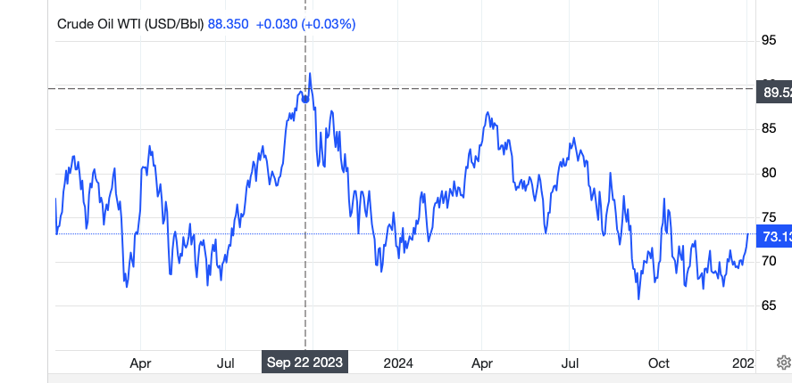
WCS and WTI vs Interest & Inflation
Optimal Model_1:
y = -36.4490 - 0.05159945*X₁+ 38.6286*X₂ + 9.1214 *X₃ - 3.8267*X₄ + 0.1687*X₅
y= WTI
X: [Month, Inflation Rate ,Ten_Year_Bond, Federal Rate, WCS]
R² Score: 0.8076

Slide 11
WCS and WTI vs Geopolitical Risk
Geopolitical Index
Measure of global geopolitical risks based on archives of newspapers
Built using automated text analysis of articles from major international newspapers
Data
Model was trained using worldwide GPR index, WTI (West Texas Intermediate) and WCS (Western Canadian Select) prices
Contains monthly prices starting in 1986
Model
Linear regressions model
Two hidden layers with 80 and 50 neurons

Slide 12
WCS and WTI vs Geopolitical Risk
Key Findings
WTI vs GRP
Strong correlation between WTI and GRP
Global GRP is a reasonable indicator of WTI price changes
Additional economic factors can improve the model
WSC vs GRP
Weak correlation correlation between WSC and GRP
GRP has little to no effect on WSC price changes
Model | Hidden Layer 1 | Hidden Layer 2 | Batch Size | Epochs | Validation Loss | Test MAE | R² Score
WTI vs GRP | 80 | 50 | 16 | 100 | 162.65 | 8.29 | 0.80
WCS vs GRP | 80 | 50 | 16 | 100 | 362.96 | 13.68 | 0.03

Slide 13
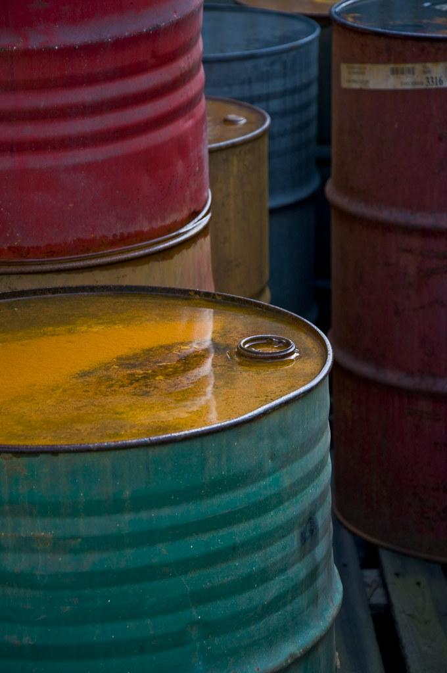
Conclusion
Therefore, the impact of interest rates and inflation on crude oil price in US and Canada are highly different. The US crude oil price is more likely affected by Federal monetary policy and inflations. However, in Canada those factors have much less impact on Canadian crude oil price.
The model’s poor performance for WCS and WTI vs GDP suggest the WCS and WTI price fluctuations are influenced by multiple macroeconomic and market driven factors beyond GDP. To create better performance model( how crude oil prices is affected by economy)would be by taking into account more macroeconomic factors such trade policies, or having a larger time frame,rather than solely focusing on one.
WTI prices are affected by GRP whereas, WCS prices are not affected by GRP index.This may be because WCS is specific to oil produced in Canada, whereas WTI serves as a global benchmark for crude oil prices.

Slide 14
References
Crude oil price
https://economicdashboard.alberta.ca/dashboard
GDP per capita
https://data.worldbank.org/indicator/NY.GDP.PCAP.KD?locations=CA-US
US Fed policy interest rate
https://fred.stlouisfed.org/series/FEDFUNDS
BoC policy interest rate
https://www150.statcan.gc.ca/t1/tbl1/en/cv.action?pid=1010013901
Geopolitical Risk Index: measure of adverse geopolitical events based on a tally of newspaper articles covering geopolitical tensions, and examine its evolution and economic effects since
https://www.policyuncertainty.com/gpr.html

Slide 15

Thank You

